Slide 1




Data Analysis Bootcamp

Slide 2







Meet The Data Team
Afnan
Al-Shammari
Reuof
Al-Qahtani
Najwa
Al-Sanani
Leen
Al-Shehri
Bayan
Al-Harbi

Slide 3



Problem Statement
Dataset Overview
User Behavior
User Transactions
Notifications and Device type for each user
Churn Rate
RFM Metrics
Recommendations
Outline

Slide 4


Problem Statement
Challenge :
Solution :
Utilize user data and analytics for personalized recommendations and proactive communication, fostering seamless user experiences and long-term engagement.
Improve user behavior and reduce churn rate

Slide 5

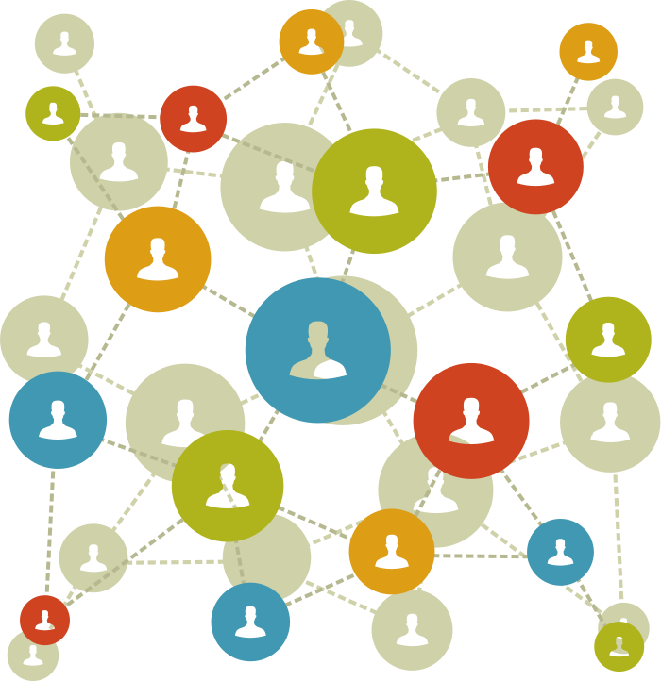




Dataset Overview
Notifications
User
Device
Transactions

Slide 6


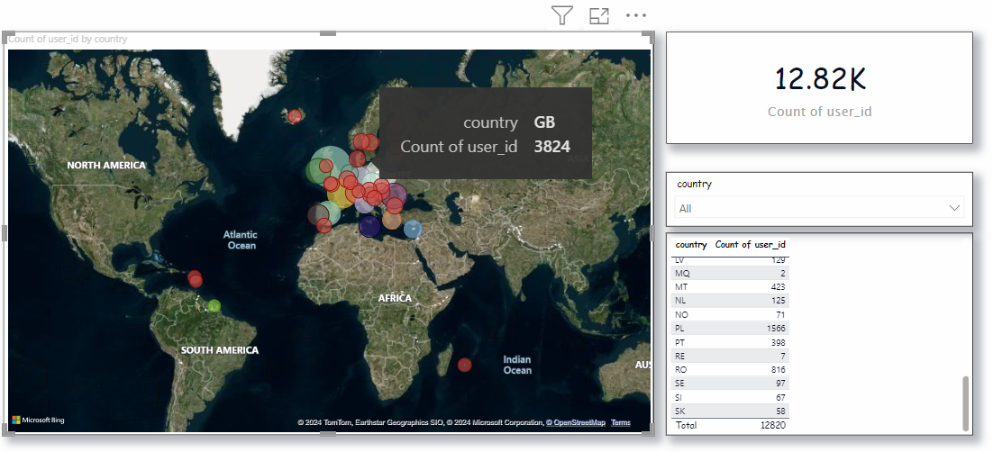
Describe where the most active of user’s located based in the country
User Behavior

Slide 7

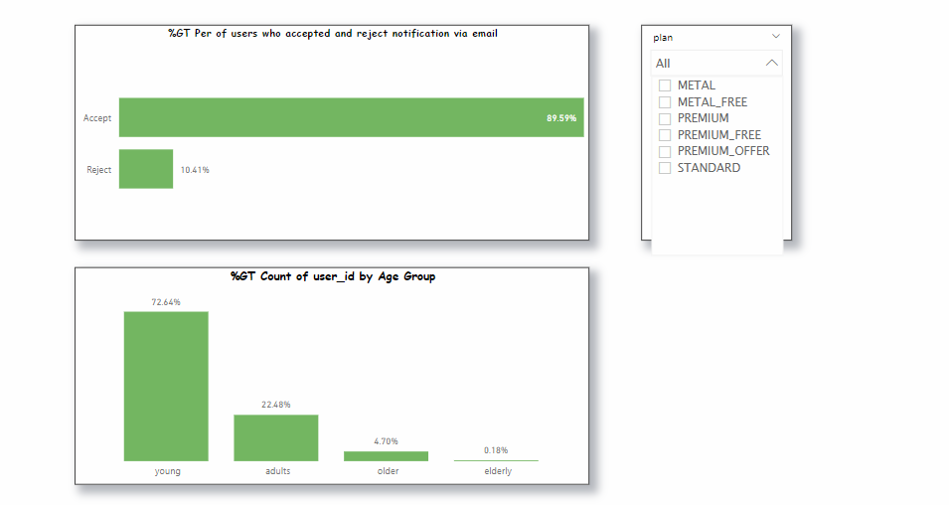
We divided the age groups into 4 categories: of our bank customer to can see the most of age used our app.
User Behavior

Slide 8

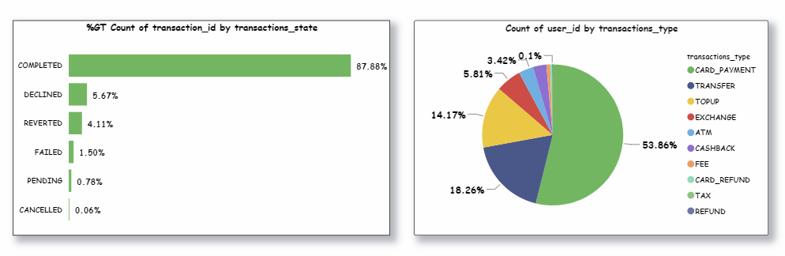
User Transactions
We have counted the most frequently used of transaction_type based on transaction_ID.

Slide 9
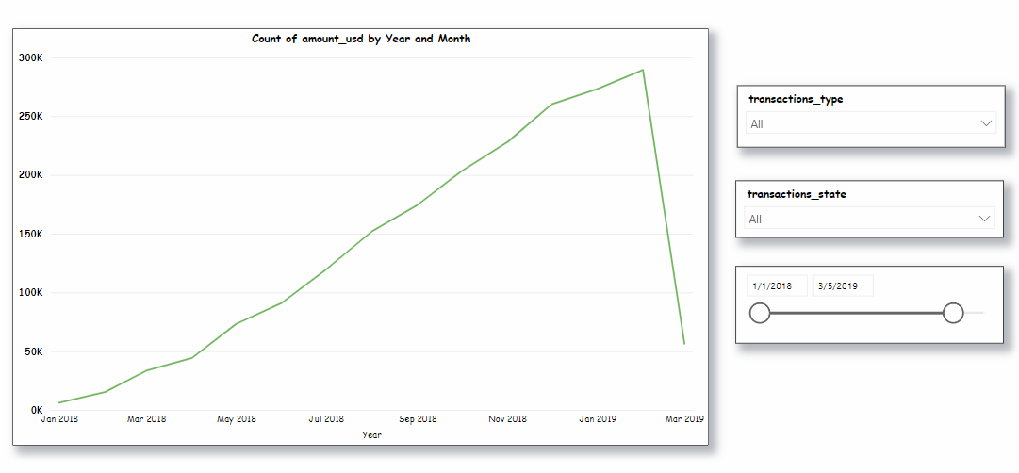

User Transactions
The chart for analysis count amount usd by year and month

Slide 10
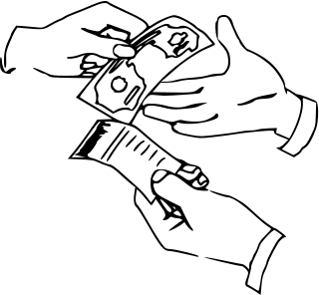
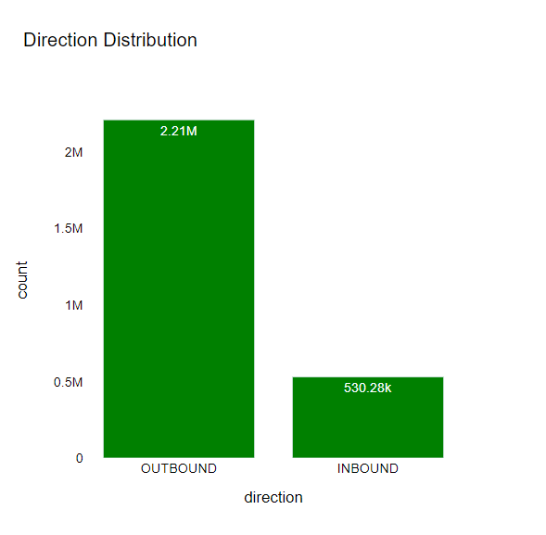
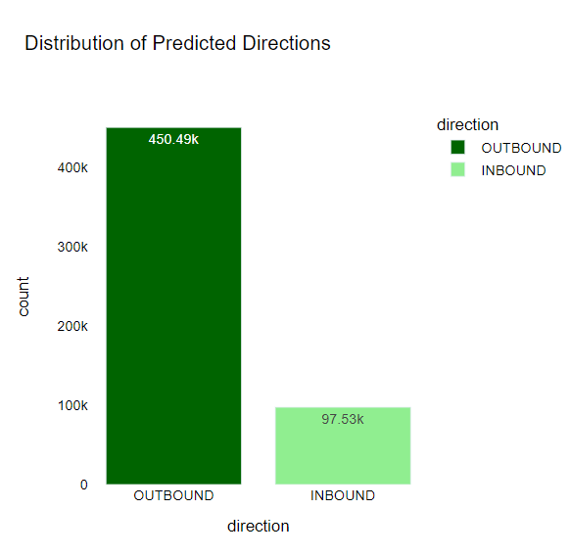

Presents a detailed statistical analysis of user transactions, including the distribution of predicted directions and the distribution of outbound and inbound directions.
User Transactions

Slide 11
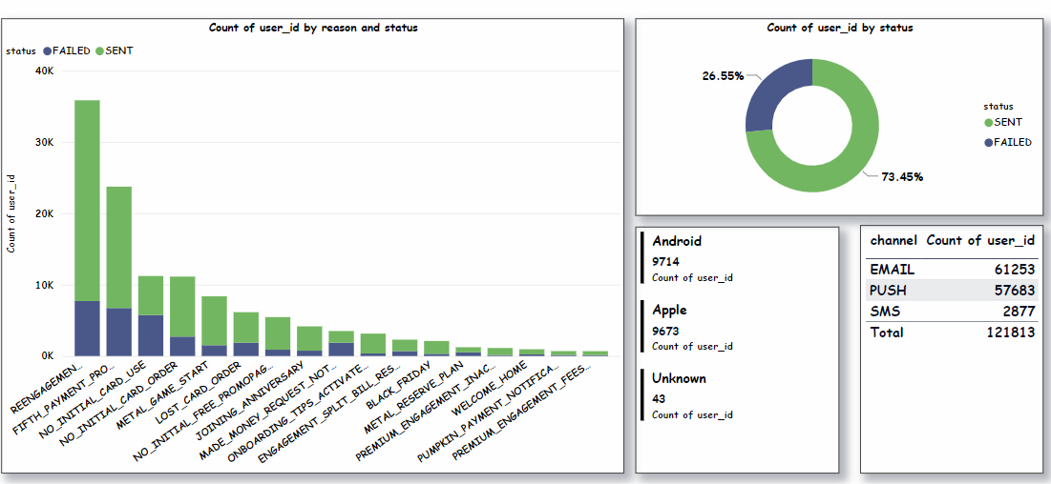
Notifications and Device type for each user
Presents two types of status, also show the most commonly used brands and channels by users.

Slide 12

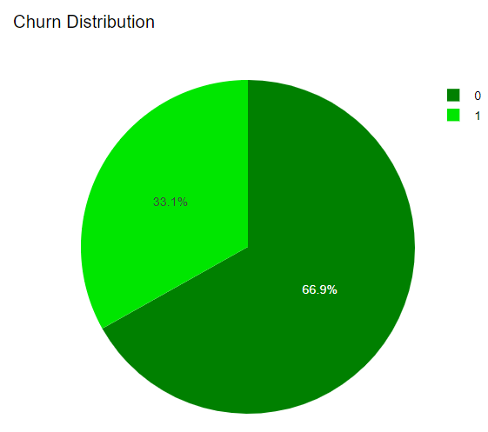
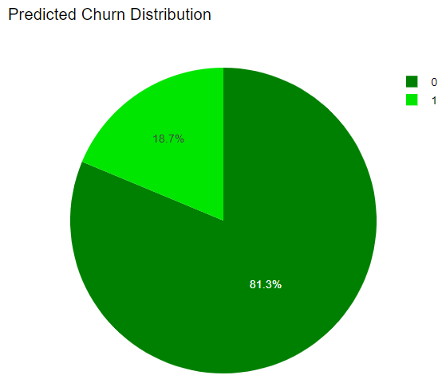
Churn Rate
We have seen a significant increase in the number of customers has gained.
Accuracy: 0.71

Slide 13

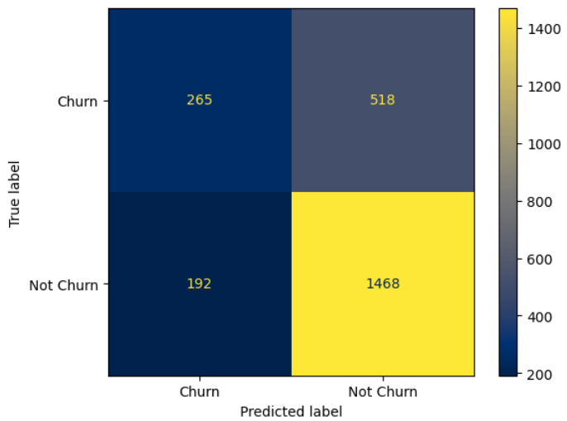
Churn Rate
The confusion matrix for churn rate

Slide 14

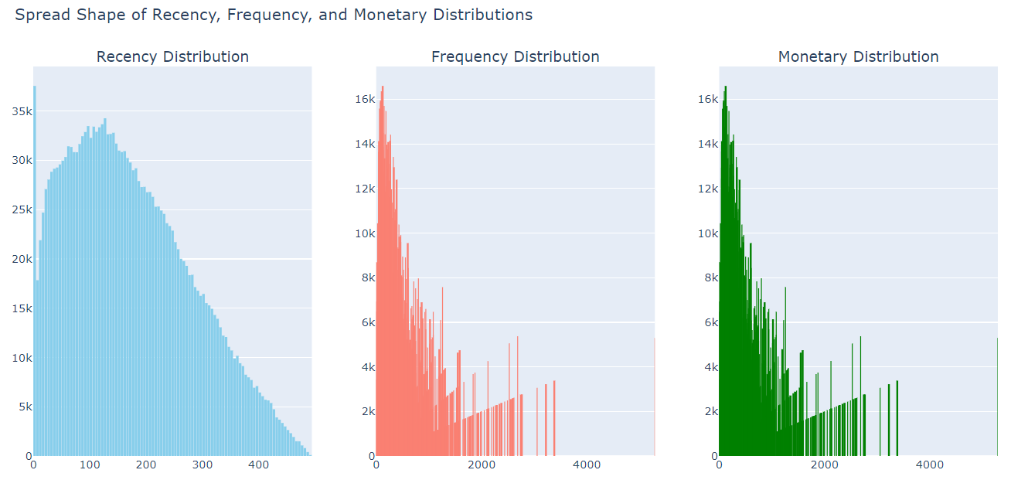
RFM Metrics
The RFM Metrics is (Recency , Frequency , Monetary )

Slide 15
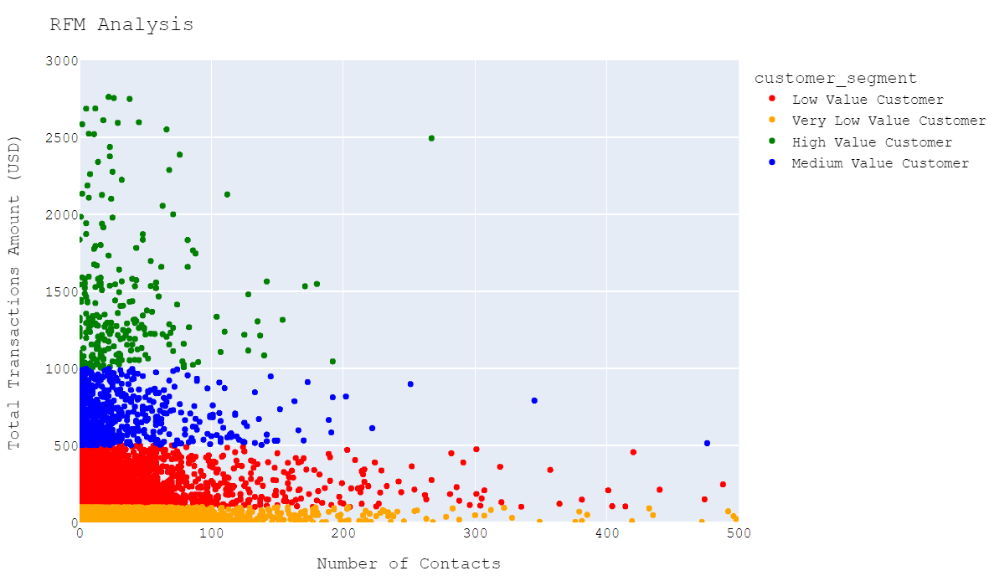

RFM Metrics
Analysis of an RFM for a customer base, segment customers to different based on their behaviors.

Slide 16


Recommendations
Focus marketing on adult audiences.
We need to develop and expand our services in other countries.
We should improve our service and marketing strategies.
We should develop strategies to improve customer loyalty and prevent churn.
We should explore ways to increase the value and engagement with these customers.

Slide 17
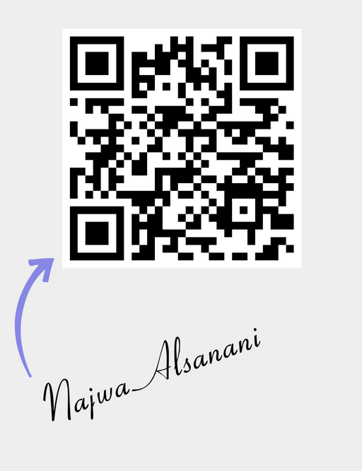
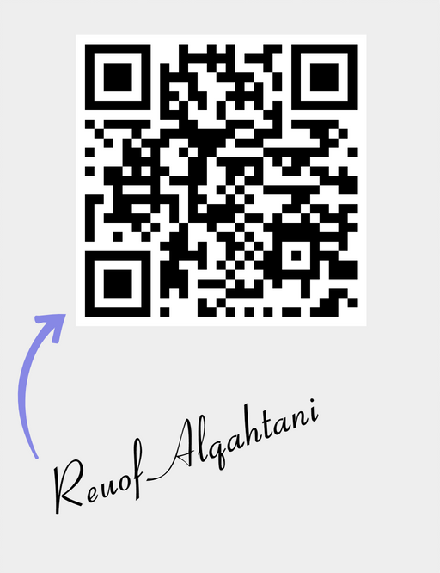
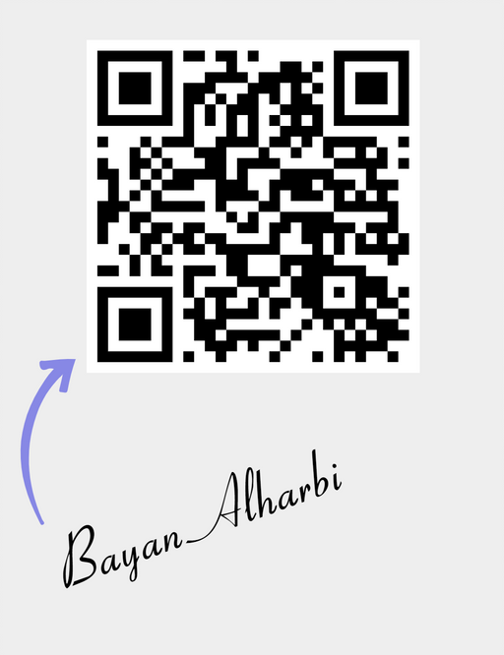
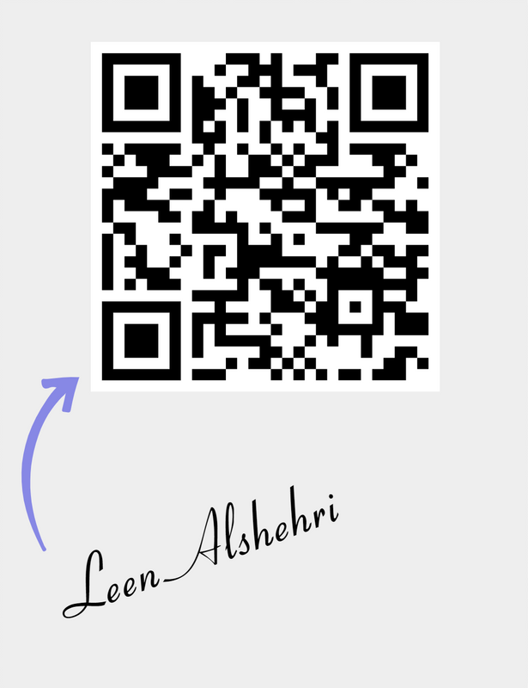
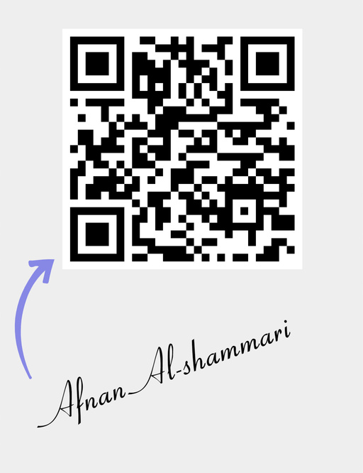

Contact with us !

Slide 18

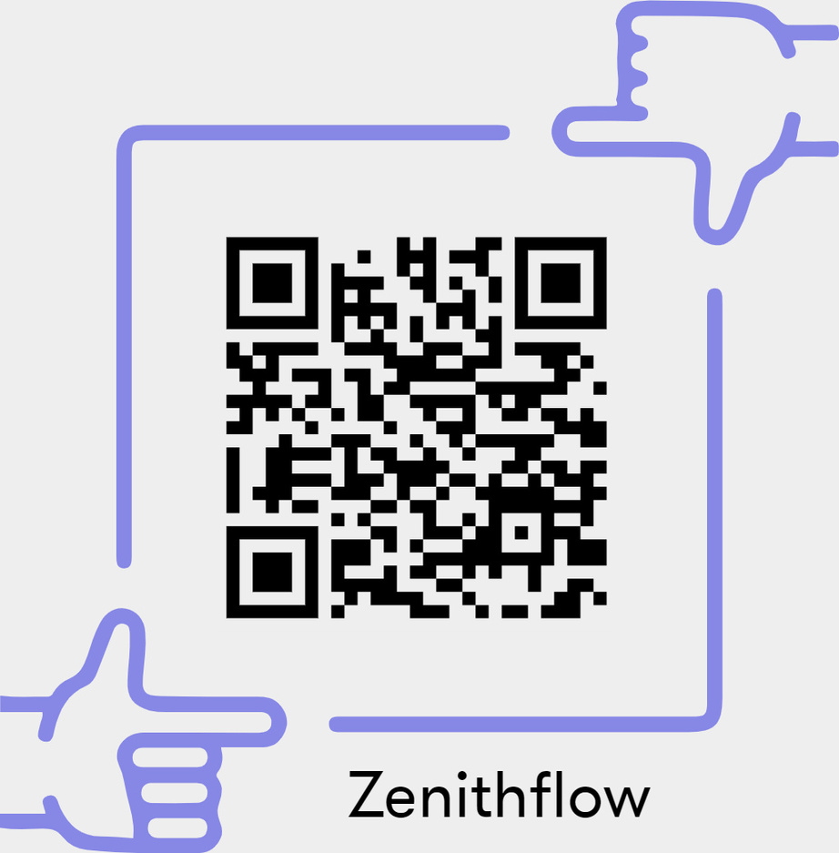
You can find our project in the GitHub ..

